Slide 1


Slide 2

Topics
Intro to recommender systems
Collaborative Filtering vs Content-based filtering
Recommendation Engine

Slide 3
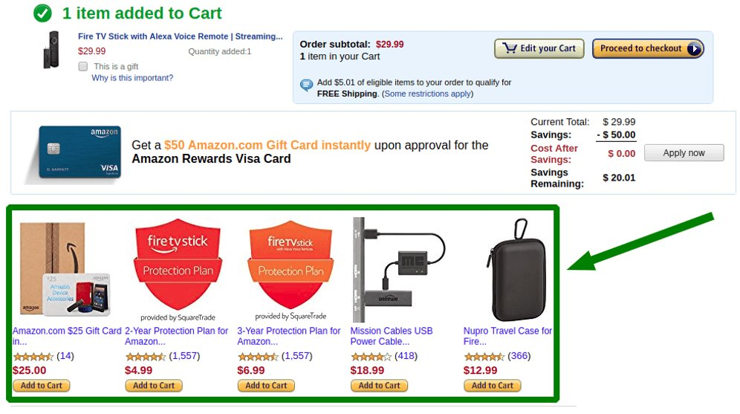

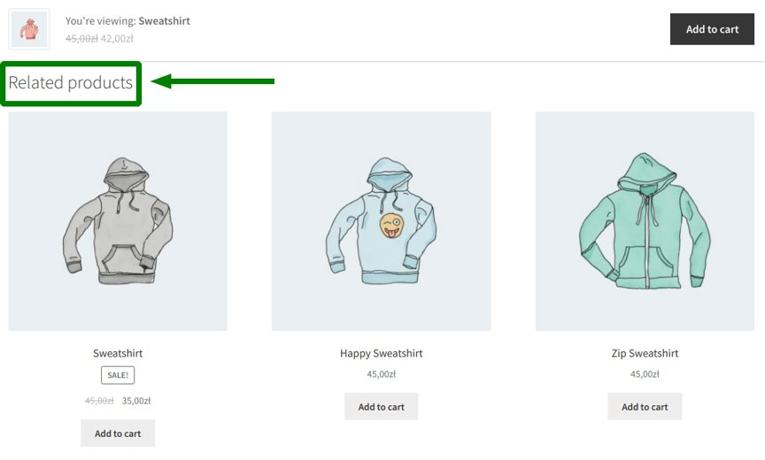
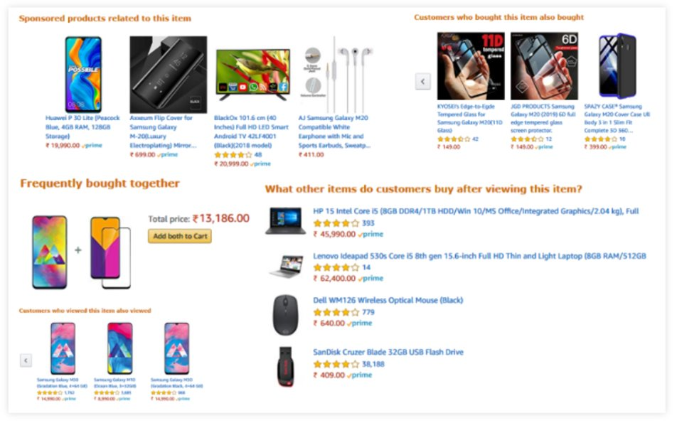
Introduction to Recommender Systems
Recommender systems aim to predict users' interests and recommend product items that are quite likely interesting to them. They are among the most powerful machine learning systems that online retailers implement in order to drive sales.

Slide 4
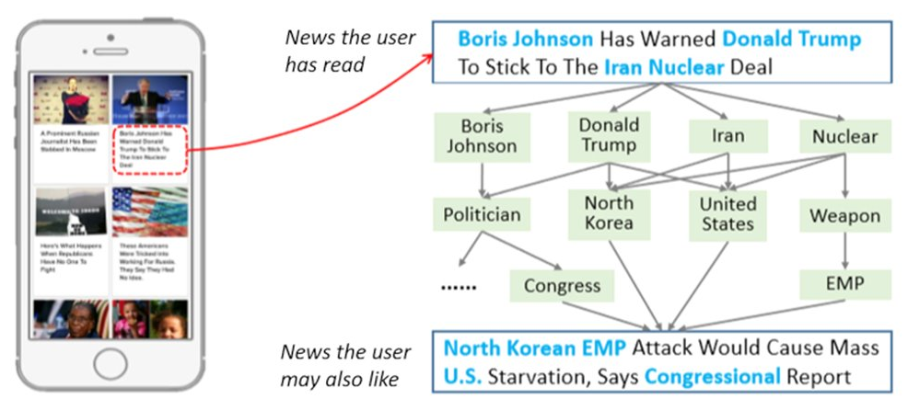
Recommendation of News Blogs

Slide 5
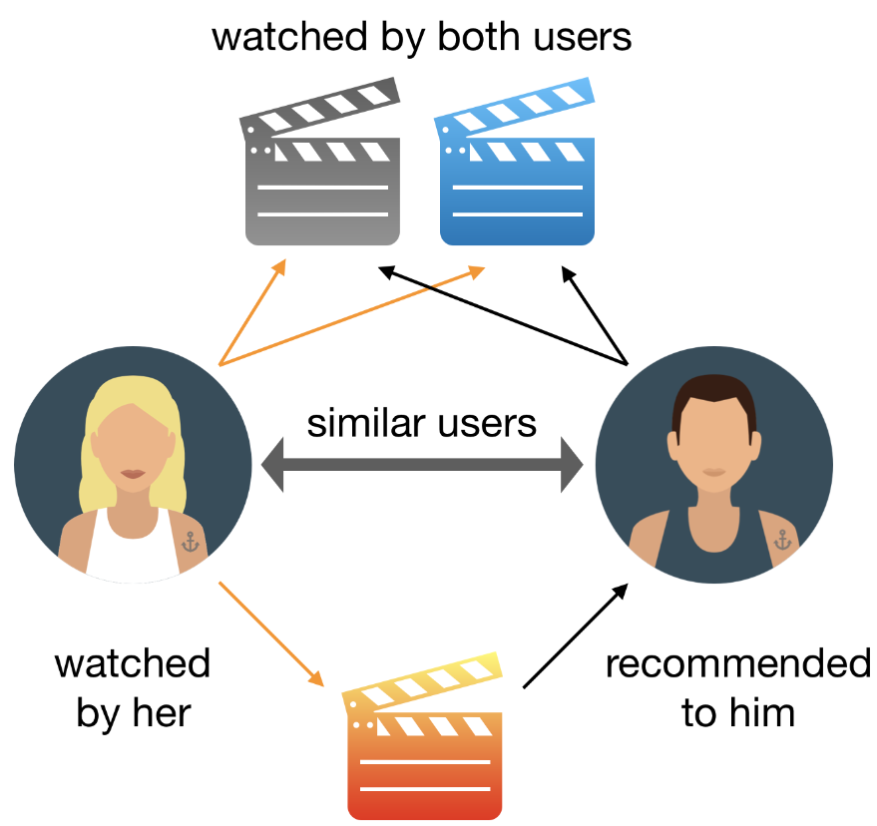
Introduction to Recommender Systems
Netflix uses a recommender system to suggest movies and TV shows that a user may want to watch. The algorithm looks at past ratings and preferences to make suggestions.
What other examples can you think of recommendation systems?

Slide 6
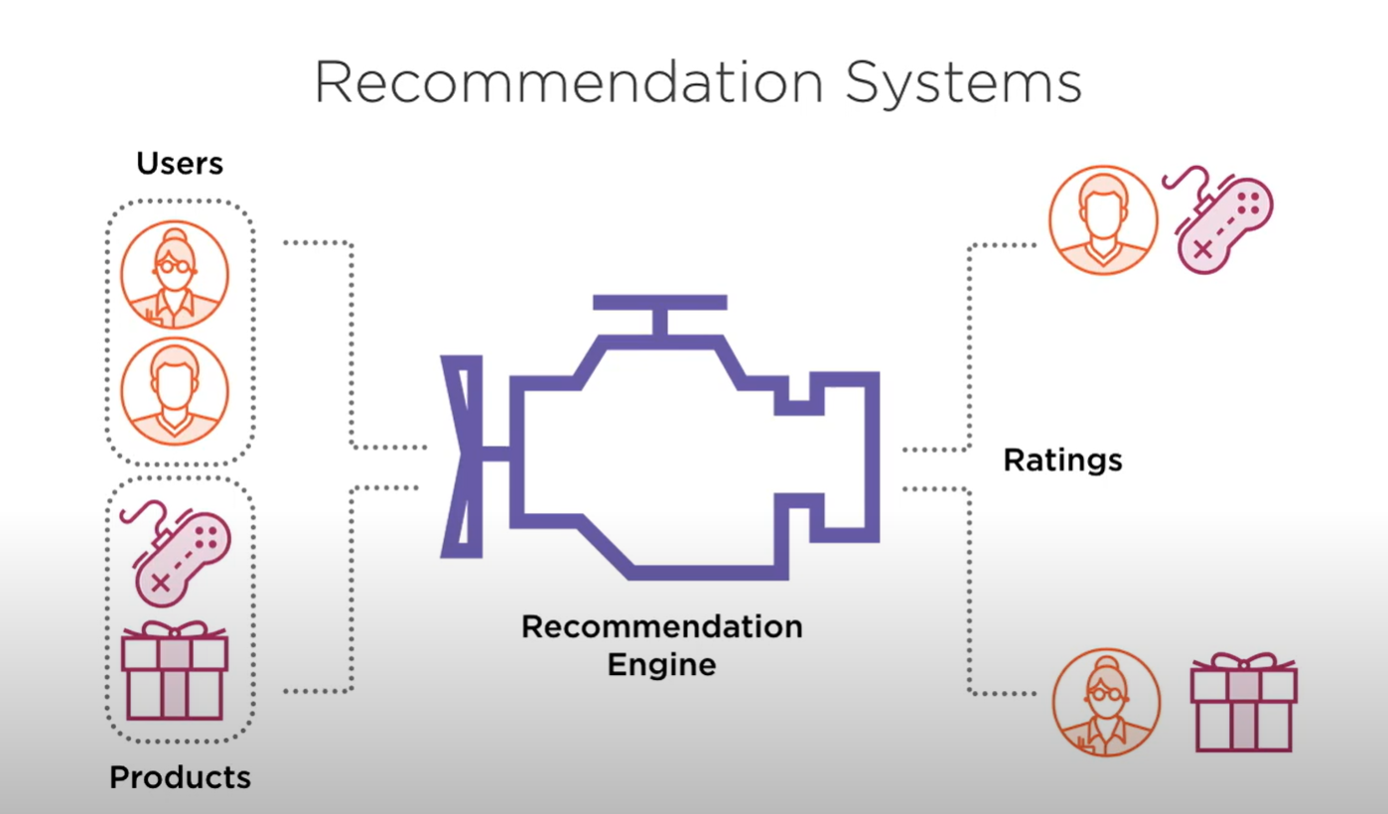
How Recommendation Systems Work?
Recommender systems function with two kinds of information:
Characteristic information. This is information about items (keywords, categories, etc.) and users (preferences, profiles, etc.).
User-item interactions. This is information such as ratings, number of purchases, likes, etc.
Based on this, we can distinguish between three algorithms used in recommender systems:
Content-based systems
Collaborative filtering systems
Hybrid systems

Slide 7
Approaches to Recommendation
Content-Based
Estimate rating using this user and this product alone
Collaborative
Employ information about other users, products too
Hybrid
Combine both content-based and collaborative filtering
Notes:
Wont be discussing Hybrid

Slide 8
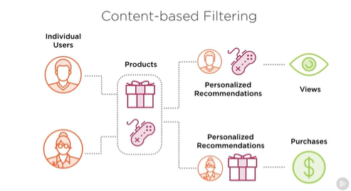
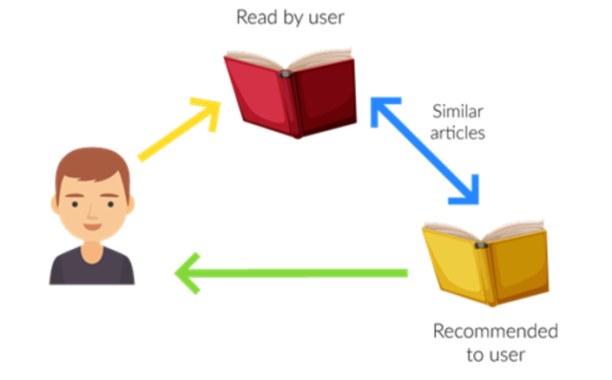
Content-Based
A content-based recommender system is a type of recommender system that relies on the similarity between items to make recommendations.
“Match Product Description to User Profile”
Notes:
For example, if you’re looking for a new movie to watch, a content-based recommender system might recommend movies that are similar to ones you’ve watched in the past

Slide 9
Limitations to Content-Based
Two Significant Drawbacks:
Requires accurate, rich product metadata
Hard to extend across product types

Slide 10

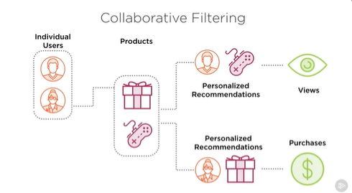
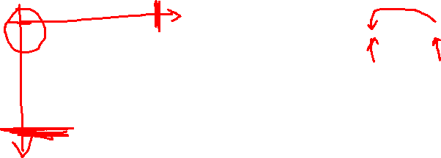
Collaborative
A collaborative filtering recommender system is a type of machine learning algorithm that makes predictions about what a user might want to buy, or watch based on the past behavior of other users. The algorithm looks at the items that other users with similar tastes have purchased or rated highly and recommends those items to the new user.
“People who buy X also buy Y”
Notes:
Users who agreed in the past will agree in the future, and that they will like similar kinds of items as they liked in the past.

Slide 11

Recommendation Engine
Notes:
Putting it all in one place

Slide 12

THANK YOU
Training and Certification

